Slide 1

Solution Presentation
Notes:
NOTE: To change images on this slide, select a picture and delete it. Then click the Insert Picture icon
in the placeholder to insert your own image.

Slide 2
TEAM MEMBERS
K. JANANI | Vaijayanthi Sambath Kumar | VARSHINEE. R

Slide 3
Where the problem arises?
During the ATM transaction there is a high possibility of fraudsters threatening the customers and performing fraudulent withdrawal and transactions.
There will be no security for the customers. Most of the times it is very difficult to identify the culprits, which will be a loss for bank and the customer.
These malpractices can occur in wee hours , most of the people may need money urgently at that time so to avoid them we can use this mechanism.
With this system of video graphed, audio authentification transaction and fingerprint mechanism attached separately to each account it is easy to nab the culprits and provide convenience , comfort and protection to customers and the organization which results in hassle free smooth banking activities.

Slide 4

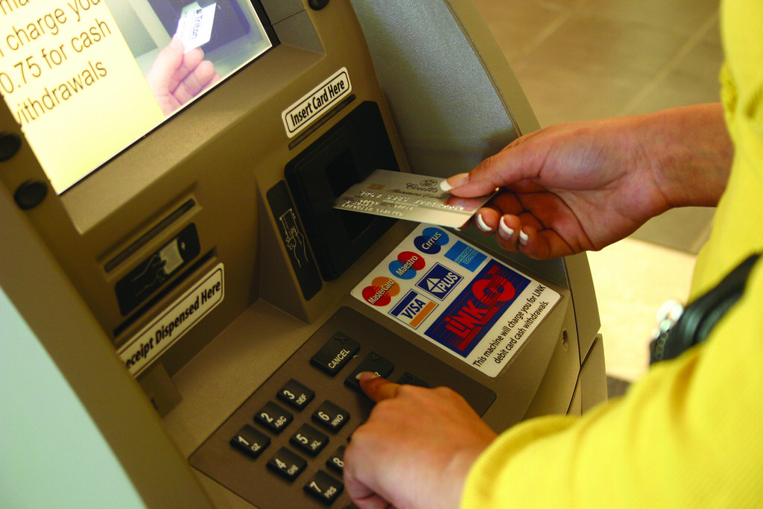
Solution
This Photo by Unknown Author is licensed under CC BY
This Photo by Unknown Author is licensed under CC BY-ND
Notes:
NOTE: To change images on this slide, select a picture and delete it. Then click the Insert Picture icon
in the placeholder to insert your own image.

Slide 5
Description of the Idea
The idea is to provide extra security for ATM transaction and Avoid Malpractices like Fraudulent Transfers and Withdrawals by attaching a 360-degree camera and a fingerprint identifying mechanism to the ATM so that each transaction is video graphed ,recorded along with the transaction simultaneously and saved in that respective account.
The application detects the fingerprint associated with their account to authorize the person , when the person places the finger in the allotted section the transaction continues if that person is an authorized person .
Each account can add maximum three fingerprints and three face recognitions , so that any three can withdraw from the account.
The User’s special password is recorded through audio and is connected to the bank account one must tell the password when prompted in the screen for voice authentication.

Slide 6
Description of the Idea
The camera will be active throughout the duration of each transaction of every customer capturing all the activities of the customer till they collect the cash.
If the camera is closed or the customers face is out of focus or blur, then the transaction will be cancelled.
The advantage of this idea is every account transaction is video graphed and recorded with that Account number.
It also provides double security as it has both Face capturing and Fingerprint Mechanism.
So any attack from robbers and fraudulent activities can be detected easily . This mechanism is cost effective and will serve as best security.

Slide 7

Animatic Representation of Working
This Photo by Unknown Author is licensed under CC BY-SA
Notes:
NOTE: To change images on this slide, select a picture and delete it. Then click the Insert Picture icon
in the placeholder to insert your own image.

Slide 8
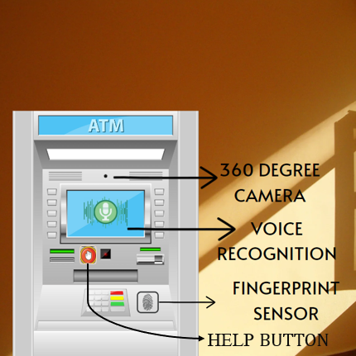

PROTOTYPE
The ATM has 3 new added features
1. Fingerprint port to scan fingerprint connected to your bank account.
2. A speaker which takes user voice and authenticates with the saved voice message.
3. 360-degree Camera which captures the video

Slide 9
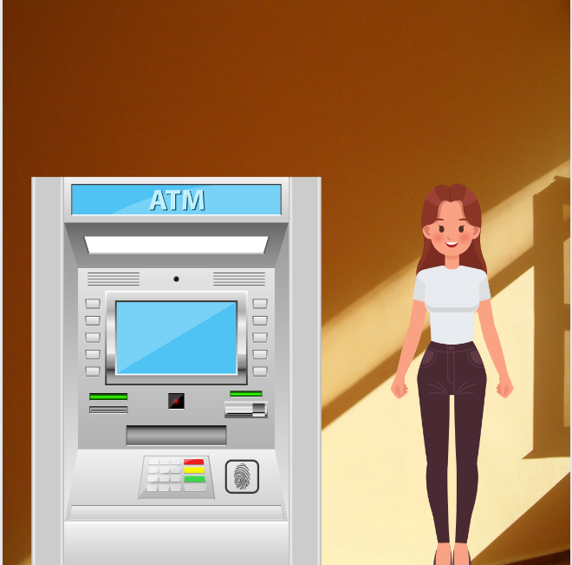
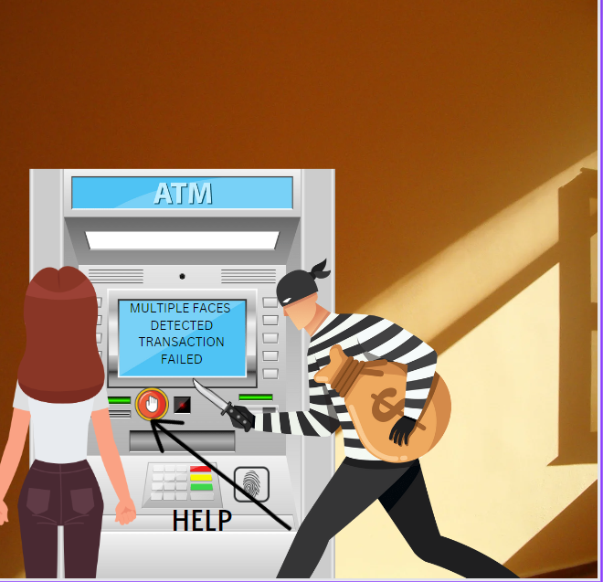
User enters the ATM for Bank transaction

Slide 10

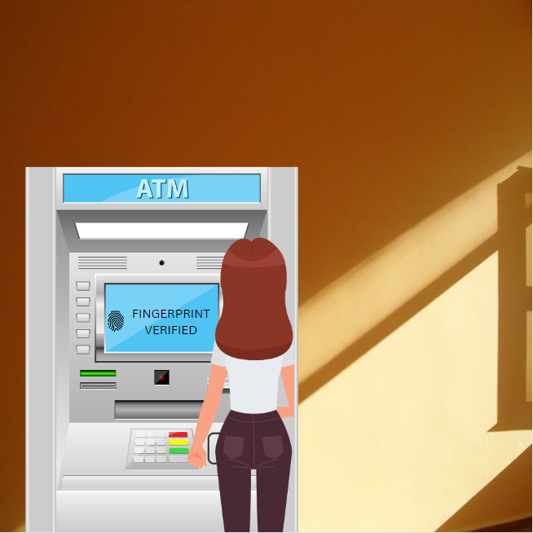

The user places her finger in the button to authenticate her fingerprint.

Slide 11
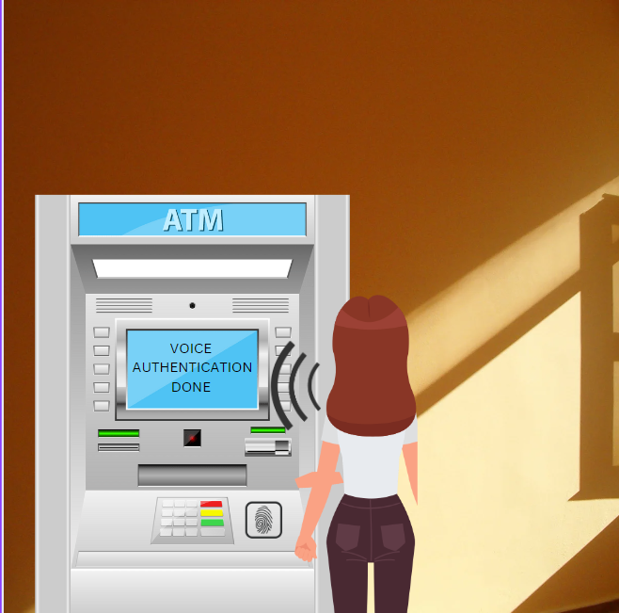
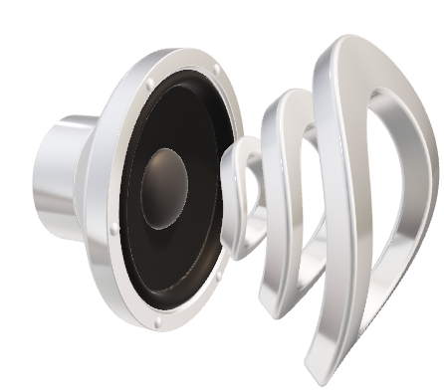
Voice authentication is done

Slide 12
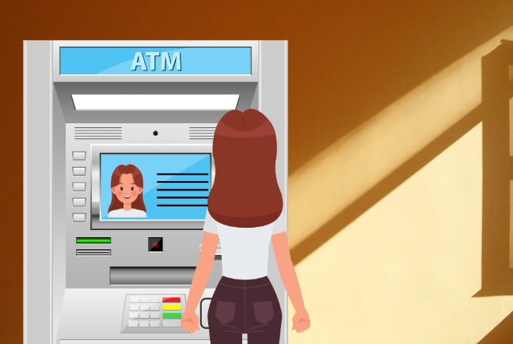
The user stands in correct position to get her face recognized and captured.

Slide 13
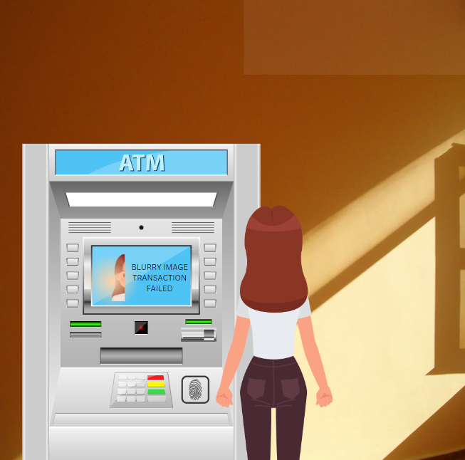
If the user moves away from the camera focus, then the transaction stops.

Slide 14
Incase of any Malpractices done by fraudsters its captured by the camera and is notified that due to the detection of multiple faces Transaction is cancelled and a Help button is provided for helping the client to connect to authorities.

Slide 15
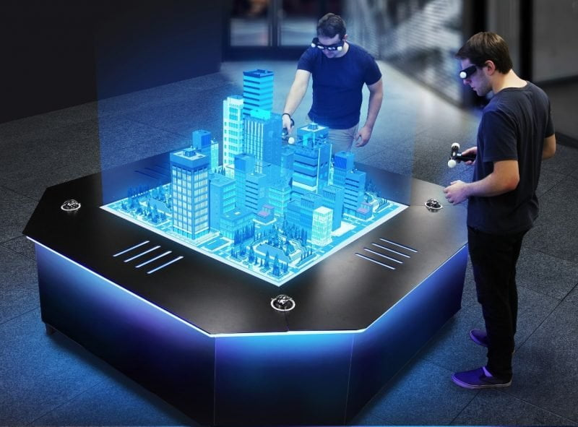
Technologies included in the project
This Photo by Unknown Author is licensed under CC BY

Slide 16
Tech Stack used to develop the solution
Tech stack:
Python
OpenCV
Machine learning
Artificial intelligence

Slide 17
Working Methodology
Face Recognition:
Opencv is an amazing tool for efficeient face recognition. Python and its libraries like numPy along with Opencv can be used to detect faces. The customers have to first capture their images at the time of account opening and the images must be trained. The images captured serve as the dataset for the face recognition mechanism. As the camera is open during the entire course of customer transaction , the customer’s face is tracked and is recognised and the image tracking process continues till the end of the transaction.
Finger Print Recognition
Each customer’s fingerprints have to be scanned, analyzed, and then stored in a coded form on a secure database.
The fingerprint of the customer is taken by the scanner and it is checked against all the fingerprints in the database that are stored during the enrollment process , and it is decided whether the customer can further continue the transaction or not.

Slide 18
SIFT ( Scale-Invariant Feature Transform) algorithm is used to match the fingerprint of the customer with the database. It is used to identify the key points and descriptors of both the test image and database images.
FlannBasedMatcher() is used for matching algorithm which facilitaes faster and efficient matching using the Cluster and Search algorithm.
Voice Recognition
Automatic Speech Recognition (ASR) is used for efficient speech recognition. The voice of the customer along with their special password has to be recorded using a microphone. When recording with microphone, the signals are stored in a digitized form . Hence, sampling has to be performed at a certain frequency and convert the signal into the discrete numerical form.
Pyaudio and SpeechRecognition (python modules) are used for recognition of spoken words. Whenever the customer tells the correct password, they can continue the transaction.

Slide 19
THANK YOU

